Slide 1
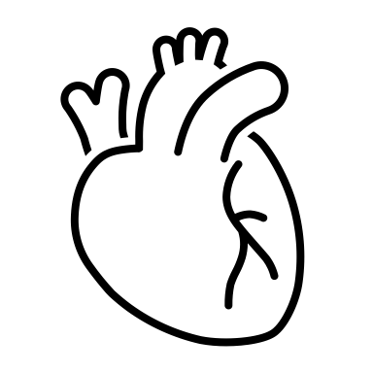
Heart Disease
Apex Heart Centre
Kassy McMahon, RN (BScN)

Slide 2
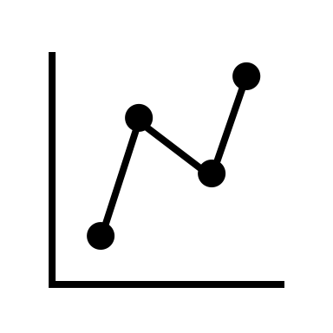
Statistics
Heart disease is the second leading cause of death in both males and females in Canada.
Men are 2 times more likely to suffer a heart attack than women.
Approximately 2.4 million Canadians live with diagnosed heart disease.

Slide 3
Heart Disease
A group of conditions affecting the heart:
  Coronary artery disease
  Arrhythmias
  Congenital heart defects
  Valvular disease
Notes:
***

Slide 4
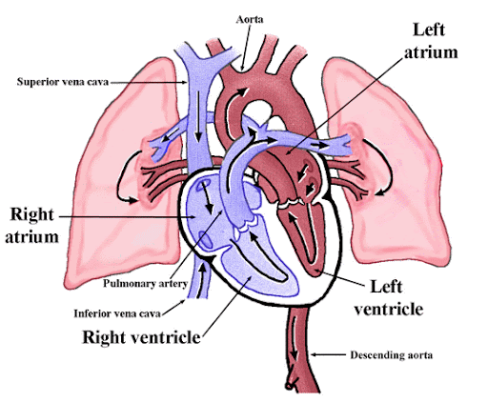
Understanding the Heart
Your body needs a constant supply of oxygen.
Arteries carry oxygen rich blood to the heart.
Veins carry blood back to the heart and lungs to pick up more oxygen.
Coronary arteries carry oxygen rich blood to the heart.
Coronary arteries deliver 250mL of oxygenated blood to the heart, each minute = 360,000 mL/day

Slide 5
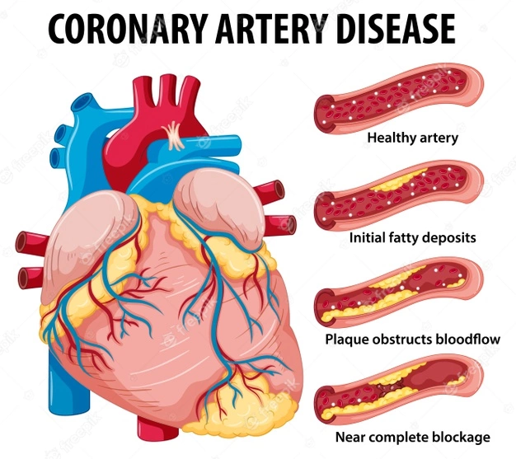
Coronary Artery Disease
The term CAD is used to describe the effects of impaired coronary artery blood flow to the heart.
One or more of the coronary arteries becomes narrowed or blocked which stops the heart from getting enough oxygen.

Slide 6
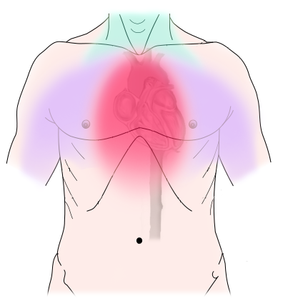
What is Angina?
It occurs when the heart muscle does not get as much blood as it needs.
Can occur during times of physical activity or stressful events.
Signs of angina include tightness, pressure or discomfort in the chest, indigestion, difficulty breathing, being tired all the time for no obvious reason, and weakness.
Type of pain of heart attack stays the same.

Slide 7
Stable Angina | Unstable Angina
Predictable Provoked by exercise, eating, emotional stress, exposure to elements (ex. Heat or cold) Relieved with rest or nitro spray | Unpredictable Can happen at any time, even when sleeping May feel discomfort you have never felt before

Slide 8
Nitro Spray
If angina occurs, relax for a moment and see if it disappears.
If discomfort does not go away use Nitro Spray.
  Spray in the air first to make sure it’s coming out of bottle
  Sit down as it may make you dizzy
  Use 5 minutes in between sprays
  If after 3 sprays the discomfort does not go away, call 911
  Nitro Spray can cause headache

Slide 9
What is a Heart Attack?
Also known as a myocardial infarction
Happens when the blood flow through one or more of the coronary arteries is blocked causing the heart to not get enough oxygen.
The site of damage depends by which coronary arteries are blocked.
The faster you can seek medical attention to unblock the artery, the less damage will be done.

Slide 10
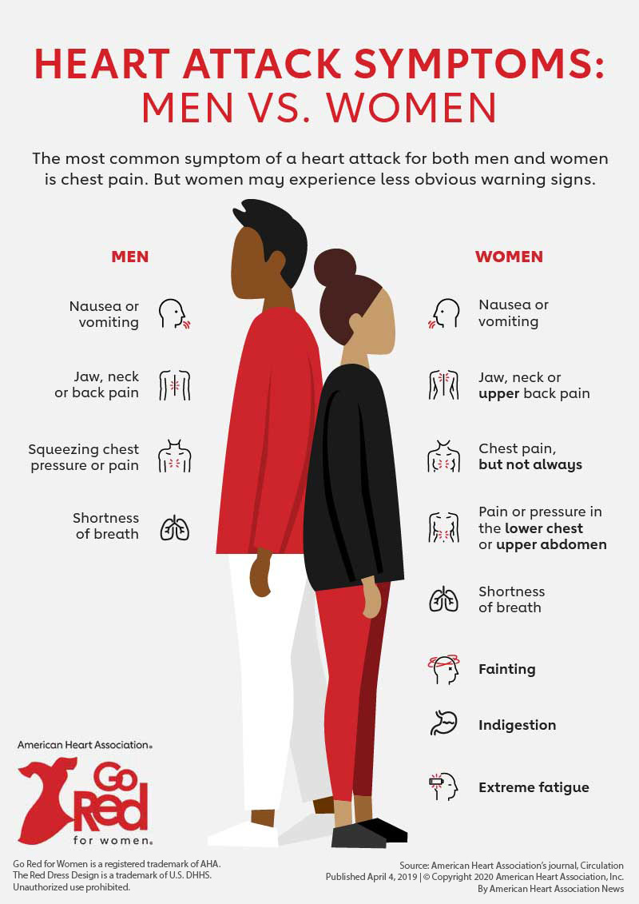
Signs and Symptoms of a Heart Attack
If you experience any of these signs, you should:
  Call 9-1-1
  Stop all activity and lie down
  If you take nitroglycerin, take your normal dosage
  Chew and swallow two 81mg tablets or one 325 tablet of ASA
  Keep a list of medications in your wallet or on your phone (easily accessible)

Slide 11
Diagnostic Testing
Blood tests to check certain enzymes.
Chest x-ray to look at the size of your heart.
Electrocardiogram to look at the electrical activity of your heart.
Exercise stress test to look at how your heart responds to exercise.
Nuclear medicine scan to look at the pumping of your heart.
Angiogram to check for blockages in the arteries.
Echocardiogram to look at the movements of your heart and measure ejection fraction.
*If you are stable, you will have a yearly check up. If unstable, call for an earlier appointment.

Slide 12
Surgery and Device Therapy
Depending on the severity, your doctor may recommend surgery. People with coronary artery disease may be considered for:
  Percutaneous coronary intervention or angioplasty
  Bypass surgery
  Implantable cardioverter defibrillator (ICD)
  Pacemaker
Notes:
Pictures of bypass/PCI

Slide 13

Medical Risk Factors for Heart Disease
High blood pressure
High cholesterol and triglycerides
Diabetes
Pre-eclampsia

Slide 14
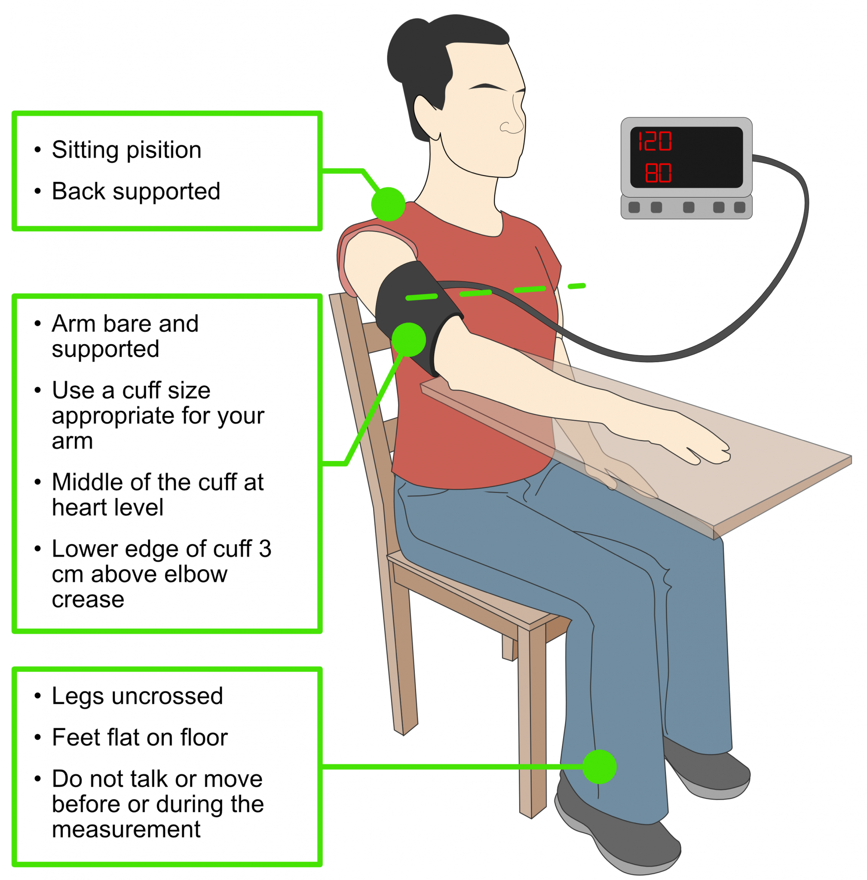
Blood Pressure
High blood pressure is when the heart must work harder than normal to pump blood through the arteries.
High blood pressure is associated with a 2 to 5x greater incidence of CAD.
Signs and symptoms of high blood pressure: fatigue, headache, vision problems
Should have own blood pressure device – can be covered by some private insurance
High blood pressure: >140/90

Slide 15
Cholesterol and Triglycerides
Three types of fats that are normally found in the blood:
  LDL cholesterol
    Bad cholesterol as it can increase plaque buildup
    Important to treat (usually *statins)
  HDL cholesterol
    Good cholesterol as it helps move bad cholesterol to the liver for breakdown
  Triglycerides
    Type of fat, not cholesterol- the body uses some calories to switch to triglycerides
    Can contribute to future risk of heart attack and strokes

Slide 16
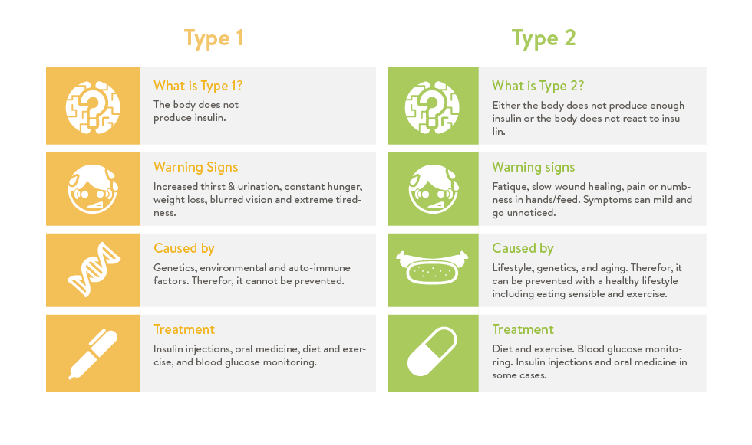
Diabetes
If your body does not make enough insulin or cannot use it properly, then you will have high blood sugar.
High blood sugar increases plaque buildup and narrowing of the arteries.
HbA1C (3-month average) should be <7.0mmol

Slide 17
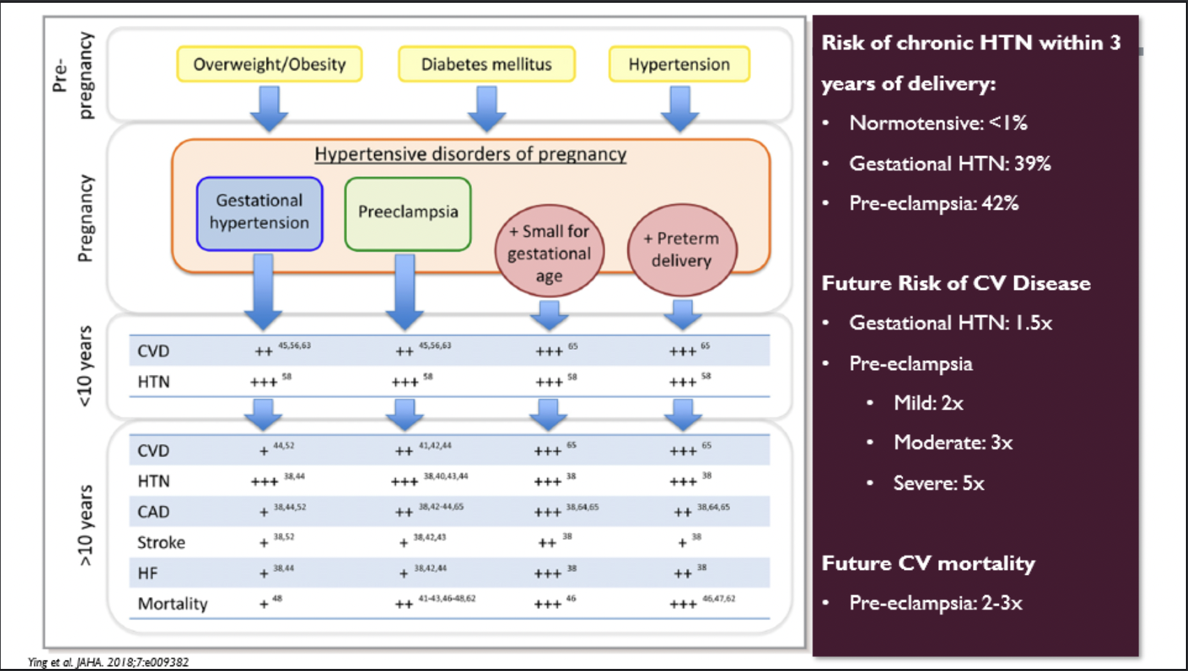
Pre-Eclampsia
High blood pressure after 20 weeks of pregnancy
Women who had pre-eclampsia during pregnancy have an increased risk of high blood pressure and heart disease.

Slide 18
Modifiable Risk Factors for Heart Disease
Obesity
Alcohol and recreational drug use
Smoking
Stress
Diet
Exercise

Slide 19
Unmodifiable Risk Factors for Heart Disease
Age
Sex
Family history
Heritage- Indigenous, South Asian, and African
Personal circumstances

Slide 20
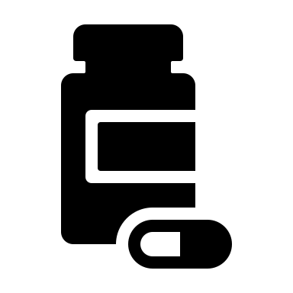
Managing your Medications
Take medications at the same time each day.
Do not change how you take your medications on your own.
If you have a hard time remembering to take medications:
  Buy a pill organizer
  Ask the pharmacy for your medications to be put in blister packs

Slide 21
Managing your Medications
Make a list of your medications and always carry the list with you (do not depend on a spouse or family member to have a list).
Bring medications to medical appointments.
Watch for interactions with food and alcohol
  Grapefruit can change the way some medications work, ex. Statins
  Some medications need to be taken with food and some on an empty stomach.

Slide 22
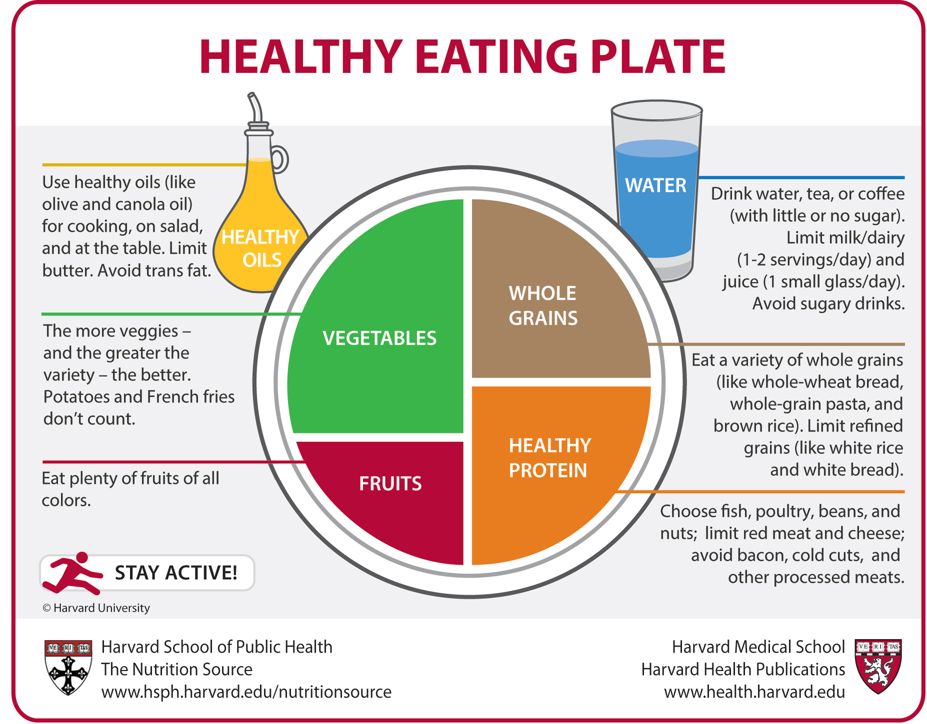
Healthy Eating
Prepare food at home as often as you can.
Use less sugar, fat, and salt when preparing or cooking meals.
Eat fewer highly processed foods (chips, deli meats, frozen pizza, sports drinks, etc.)
Try to limit alcohol intake
  Women: <9 drinks per week
  Men: <14 drinks per week

Slide 23
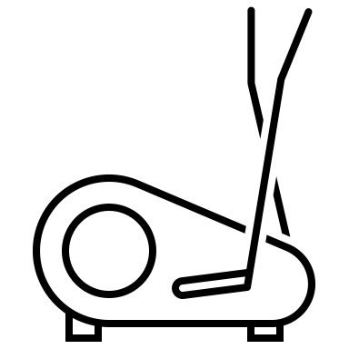
Exercise
The risk of CAD among those who live a sedentary lifestyle is almost doubled.
Recommended to exercise 150 minutes each week.
  Aerobic: Walking, bicycling, swimming, jogging
  Resistance: Lifting weights, using resistance bands
  Stretching: Yoga

Slide 24
Intensity Chart
RPE | How it feels | What you can do
0.5 | Very, very easy | Sing
1 | Very easy | You have enough breath to sing
2 | Easy
3 | Moderate | Talk
4 | Somewhat hard | You have enough breath to talk or speak
5 | Hard | Gasp
6 |  | You cannot say more than 4-6 words without gasping
7 | Very hard | You cannot say more than 2-3 words without gasping
8
9 | Very, very hard
10 | Maximum | You cannot talk
*Aim to stay within the 3 to 5 scale during your exercise

Slide 25
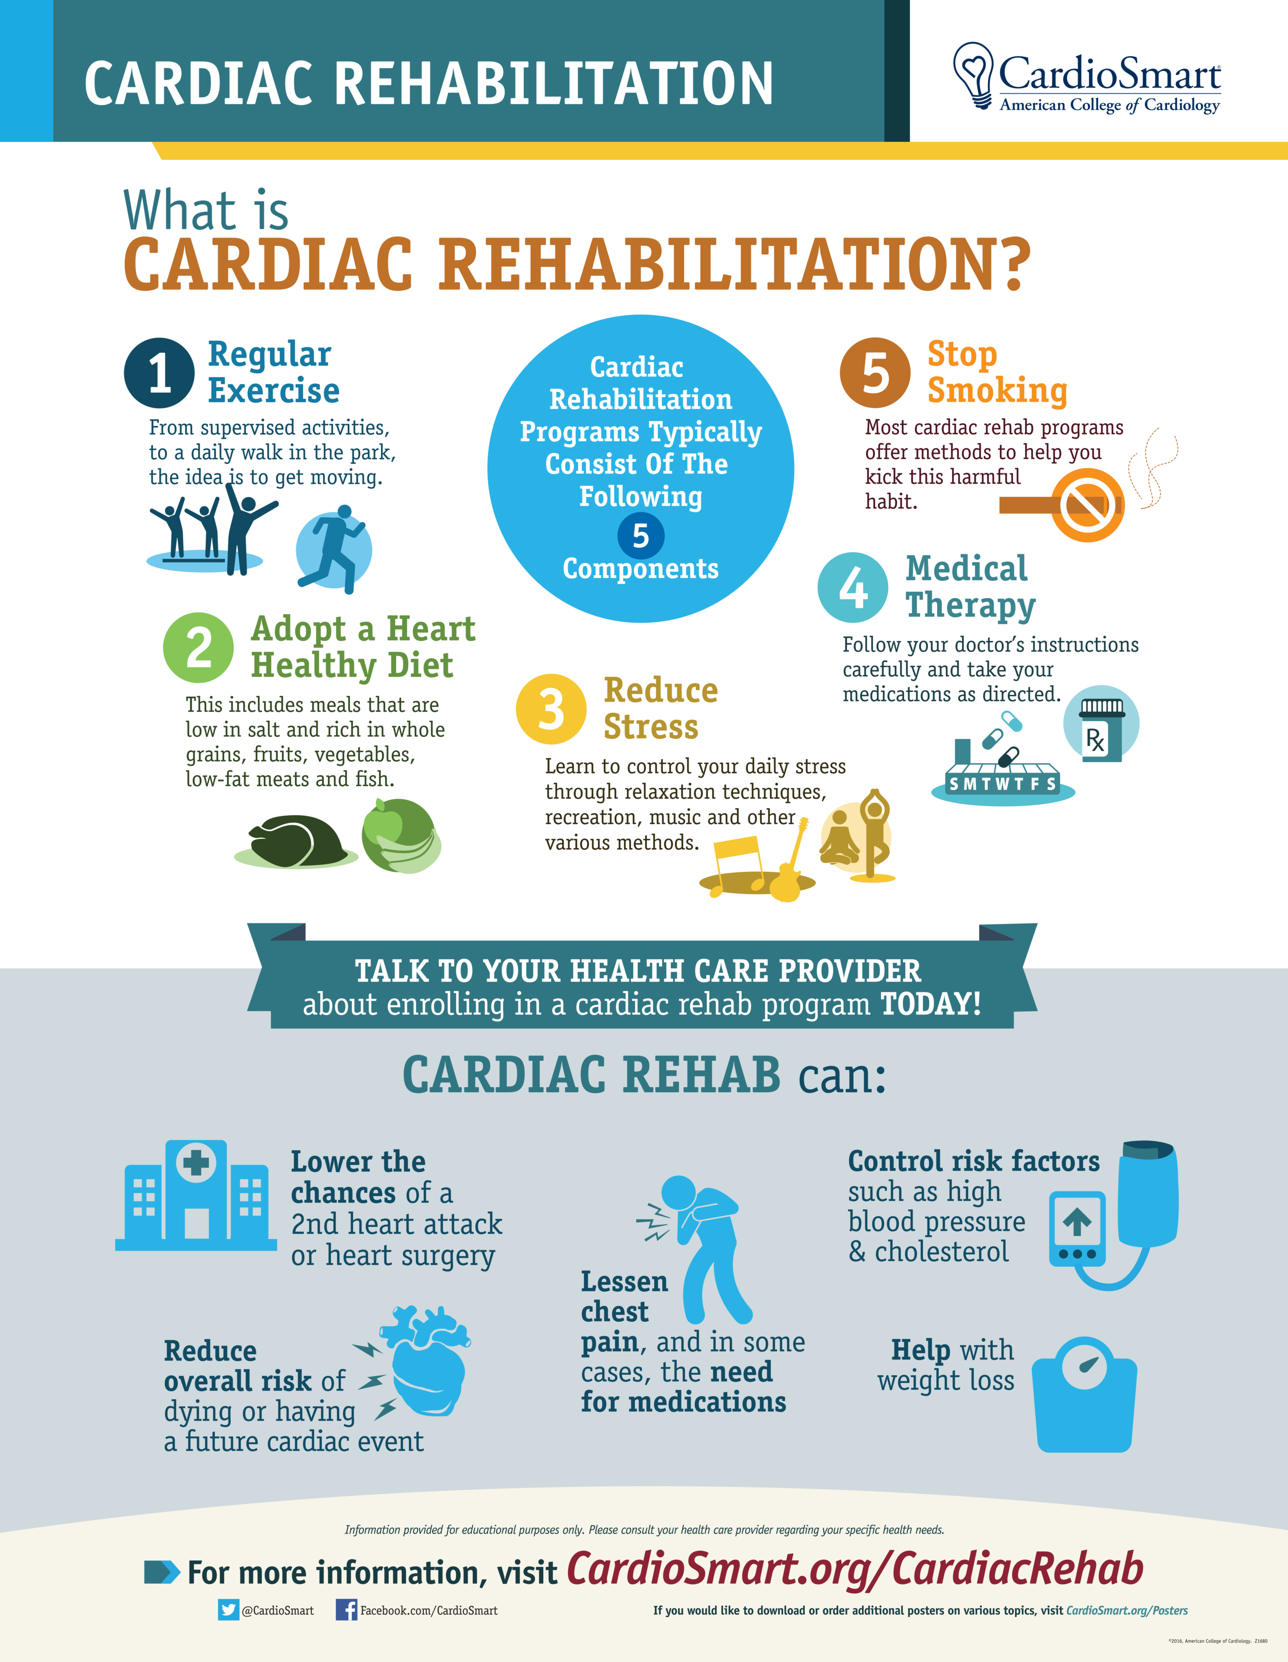
Cardiac Rehab
Specifically designed for those with CAD
Available at Napanee, Brockville and Hotel Dieu
Typically, a 6-week program

Slide 26
General Guidelines for Exercise
After a heart attack you should:
Start walking as soon as you are feeling comfortable.
Start resistance exercise when your physician tells you it is safe to do so.
After angioplasty you should:
Not lift anything over 5 pounds or lift weights until your physician tells you it is safe to do so.
After open heart surgery you may need to:
Wait up to 12 weeks before beginning exercise. When it is safe to start, start very slowly.
*Stop if you begin to have angina

Slide 27
Exercise Safety
Normal during steady exercise to experience: | NOT normal during steady exercise to experience:
Comfortable | Pain, pressure, or heaviness in your chest, neck, jaw, shoulder, or arm
Aware of breathing | Dizzy/lightheaded
Able to talk | Cold and clammy
Slightly tired | Overwhelming amount of fatigue/weakness
Dry or slightly sweaty | Nausea
Relaxed | Anxiety

Slide 28
Sexual Intercourse
Most people can return to sexual intercourse two to eight weeks after your heart attack or heart surgery.
Take your time and stop if you have chest pain.
Do not have sex in a very hot or cold place, after a heavy meal and after drinking a lot of alcohol.
Share your fears, needs, desires, and wishes with your partner about having sex again.
Medications that treat erectile dysfunction (Viagra, Cialis, or Levitra) can cause dangerous drops in blood pressure if taken within 48 hours of any form of nitrates (Nitro Spray). Never stop taking your cardiac medications because you have side effects that affect your sex life.

Slide 29
How to Make Lifestyle Changes
Stick to a routine
Use a social support network
Recognize and handle stress
Create realistic goals

Slide 30

Questions?

Slide 31
References
Harvard Medical School. (2021). Heart disease. https://www.health.harvard.edu/topics/heart-disease
Heart and Stroke Foundation of Canada. (2018). Living well with heart disease. https://drive.google.com/file/d/1NobeyyUAMVtZgebAiiwLvjBO_8-fv5dm/view
Statistics Canada. (2020, November 16). Deaths, 2019. https://www150.statcan.gc.ca/n1/daily-quotidien/201126/dq201126b-eng.htm
University of Ottawa Heart Institute. (2021). Coronary artery disease (atherosclerosis). https://www.ottawaheart.ca/heart-condition/coronary-artery-disease-atherosclerosis

Slide 32
Atherosclerosis
Grade | Degree of Artery Narrowing | Severity
I | 25% narrowing and reduction in blood flow | Minimal
II | 50% narrowing and reduction in blood flow | Moderate
III | 75% narrowing and reduction in blood flow | Severe
IV | 100% narrowing and reduction in blood flow | Complete Blockage
Fatty substances accumulate as plaque around the inner lining of the vessels.
CAD exists when atherosclerosis has reached the stage where the blood flow through the arteries is impeded.
There are 4 grades of atherosclerosis.
75% obstruction is needed to produce significant reduction in blood flow.
Notes:
To be referenced if needed.

