Slide 1

Heart Failure
Kassy McMahon, RN (BScN)
Apex Heart Centre

Slide 2
Statistics
Heart disease is the second leading cause of death in both males and females in Canada.
Approximately 2.4 million Canadians live with diagnosed heart disease.
About 600,000 Canadians are living with heart failure.

Slide 3
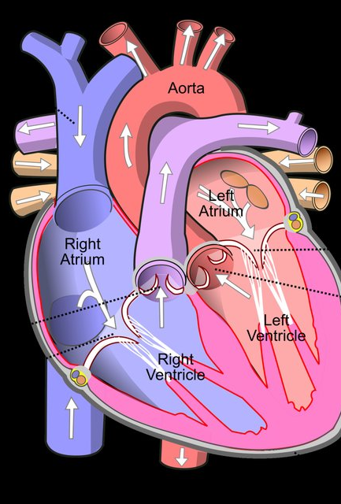
Understanding the Heart
Your body needs a constant supply of oxygen.
Arteries carry oxygen rich blood to the heart.
Veins carry blood back to the heart and lungs to pick up more oxygen.
Coronary arteries carry oxygen rich blood to the heart.
Coronary arteries deliver 250mL of oxygenated blood to the heart, each minute= 360,000mL/day

Slide 4

What is Heart Failure?
A condition that develops after the heart becomes damaged or weakened.
Occurs when the pumping action of the heart is not strong enough to move the blood.
Can cause fluid to back up into your lungs and in other parts of the body such as your ankles.
There is no cure, however, lifestyle modifications and treatment options can help manage your condition.

Slide 5
Causes of Heart Failure
Most common cause is damage to the heart muscle caused by a heart attack
Second most common cause is high blood pressure.
Less common causes include heart valve disease, myocarditis, excessive use of alcohol or drugs, diabetes, and obesity

Slide 6
Signs and Symptoms of Heart Failure
Shortness of breath (especially when laying flat)
  You find it easier to sleep by adding pillows or sitting up in a chair
Sudden weight gain (more than 3lbs over 1-2 days)
Fatigue
Bloating or feeling full all the time
Increased swelling at the ankles, feet, legs or abdomen
Increased urination at night
  Gravity causes more blood flow to the kidneys when you are lying down.

Slide 7
Heart Failure Zones
Green Zone | No shortness of breath or chest discomfort. No swelling in feet, ankles, legs, or stomach. No weight gain of more than 4lbs over 2 days in a row.
Yellow Zone | You feel more short of breath than usual. You find it easier to sleep by adding pillows. You have increased swelling in your feet, ankles, legs, or stomach. You gain more than 4lbs over 2 days in a row. You have vomiting/diarrhea that lasts more than 2 days.
Red Zone | You are struggling to breathe. Shortness of breath does not go away while sitting. You have a fast heartbeat that does not slow down with rest. You have chest pain that will not go away with rest or nitroglycerine. You are feeling confused/you have fainted.

Slide 8
Diagnostic Testing
Blood tests to check certain enzymes and kidney function.
Chest x-ray to look at the size of your heart.
Electrocardiogram to look at the electrical activity of your heart.
Exercise stress test to look at how your heart responds to exercise.
Nuclear medicine scan to look at the pumping of your heart.
Angiogram to check for blockages in the arteries.
Echocardiogram to look at the movements of your heart and measure ejection fraction.

Slide 9
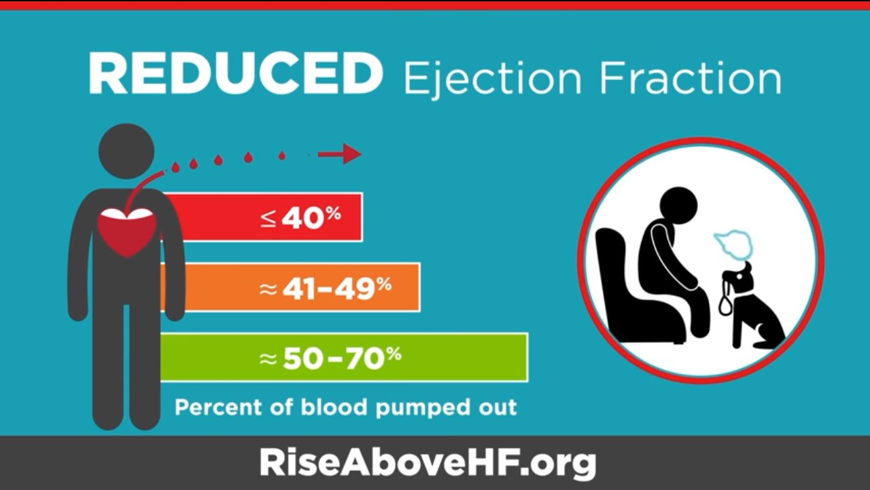
Ejection Fraction
Refers to how well your left ventricle pumps blood with each heartbeat.
Physician may order an echocardiogram or a nuclear medicine scan to determine your ejection fraction.
Less than 55% means your heart is not pumping as strongly as it should be.
Your ejection fraction can go up and down depending on your heart condition and how well the treatment is working.

Slide 10
Treatment
Heart failure needs lifelong management.
Physicians can correct heart failure by treating the underlying cause.
Usually treated with a combination of medications.
  Depends on your symptoms
  ACE Inhibitors, Angiotensin II Receptor Blockers, Beta Blockers, Diuretics, Aldosterone Antagonists
  Sick day: Illness with vomiting and cannot maintain oral intake- do not take medications except for beta blockers as it can affect electrolytes and kidney functions

Slide 11
Managing HF- Weight Check In
When your kidneys don’t filter enough blood, your body holds onto extra fluid.
Checking your weight everyday lets you know if your body is retaining fluid.
Excess fluid makes your heart work harder.
You should weigh yourself at the same time everyday. Preferably before breakfast.
If your weight increases by:
  More than 2kg (4lbs) in two days OR more than 2.5kg (5lbs) in 1 week
  You are retaining fluid and should call your health care provider.

Slide 12
Managing HF-Limiting Sodium
Sodium causes your body to hold on to fluid.
In the average Canadian diet, readily-made processed foods and restaurant meals make up 77% of sodium in take.
No processed foods, deli meats, pickled foods, salted snacks, and canned foods.
Do not add table salt to foods.
No salt substitutes- they are very high in potassium.

Slide 13
Managing HF-Limiting Fluid
Fluid can build up causing swelling in your feet, legs or stomach making your heart work harder.
Drink when thirsty.
Weighing yourself is important to see how much fluid your body is holding on to.
Eat plenty of fiber- restricted fluid levels may cause constipation.

Slide 14
Managing HF- Potassium
Normal potassium level is 3.5-5.0 mmol/L (Hypokalemia= <3.0mmol/L Hyperkalemia= >6.0mmol/L)
Medications for heart failure may affect the level of potassium in your body.
  Some diuretics cause loss of potassium so we may encourage high dietary potassium intake (ex. Hydrochlorothiazide, chlorthalidone, indapamide).
  Some ACE inhibitors, ARBs and aldosterone antagonists increase potassium levels, and you may need to decrease potassium in your diet (ex. Perindopril, candesartan, spironolactone).

Slide 15
Managing HF- Potassium
Foods HIGH in Potassium | Foods LOW in Potassium
Spinach (cooked) Broccoli Potatoes Milk and dairy products Tomato juice Tuna Beans Salt substitutes Brown and wild rice Meat and poultry | Apples Grapes Mango Peach Pineapple Lettuce Green onions Corn (canned) Celery

Slide 16
Exercise
Heart failure patients who exercise are less likely to be hospitalized and report a better quality of life.
Recommended to exercise 150 minutes each week.
  Aerobic: Walking, bicycling, swimming, jogging
  Resistance: Lifting weights, using resistance bands
  Stretching: Yoga

Slide 17
Intensity Chart
RPE | How it feels | What you can do
0.5 | Very, very easy | Sing
1 | Very easy | You have enough breath to sing
2 | Easy
3 | Moderate | Talk
4 | Somewhat hard | You have enough breath to talk
5 | Hard | Gasp
6 |  | You cannot say more than 4-6 words without gasping
7 | Very hard | You cannot say more than 2-3 words without gasping
8
9 | Very, very hard
10 | Maximum | You cannot talk
*Aim to stay within the 3 to 5 scale during your exercise

Slide 18
Tips for Exercise
Avoid exercises that require holding your breath- ex. Pushups, sit-ups
Wait at least one hour after eating to exercise
Exercise when you have the most energy- for people with heart failure, that is typically in the morning
Avoid exercising outdoors in extreme weather or high humidity

Slide 19
Exercise Safety
Normal during steady exercise to experience: | NOT normal during steady exercise to experience:
Comfortable | Pain, pressure, or heaviness in your chest, jaw, shoulder, or arm
Aware of breathing | Dizzy/Lightheaded
Able to talk | Cold and clammy
Slightly tired | Overwhelming amount of fatigue/weakness
Dry or slightly sweaty | Nausea
Relaxed | Anxiety

Slide 20
Managing Medications
Take medications at the same time each day.
Do not change how you take your medications on your own.
If you have a hard time remembering to take medications:
  Buy a pill organizer
  Ask the pharmacy for your medications to be put in blister packs

Slide 21
Managing Medications
Make a list of your medications and always carry the list with you (do not depend on a spouse or family member to have a list)
Watch for interactions with food and alcohol
  Grapefruit can change the way some medications work, ex. Statins
  Some medications need to be taken with food and some on an empty stomach
  Alcohol can cause low blood pressure
    Try small amounts to see how your body reacts
    Men: <14 drinks a week
    Women: <9 drinks a week

Slide 22
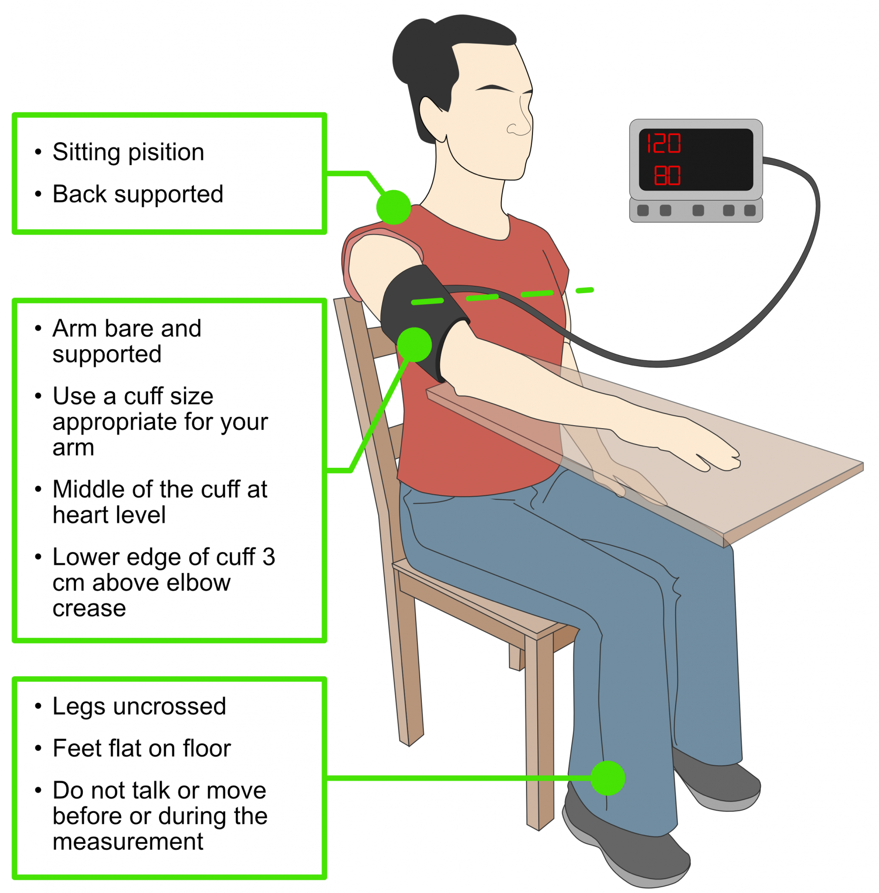
Blood Pressure
Signs and symptoms of high blood pressure: fatigue, headache, vision problems.
Should have own blood pressure device – can be covered by some private insurance with a prescription from a physician.
Try to take your blood pressure at least once a week.
  Before you visit your physician, you should measure your blood pressure morning and evening for 3 days.
Systolic should be <130
Diastolic should be <90

Slide 23
Sexual Intercourse
Once your signs of heart failure are under control, you should be able to have an active and safe sex life.
Wait at least 1 hour after eating.
Stop and rest if you get short of breath or feel uncomfortable.
Share your fears, needs, desires, and wishes with your partner about having sex again.

Slide 24
Everyday
Weigh yourself in the morning before breakfast and document it.
Take your blood pressure everyday and document it.
Take your medication the way the physician prescribed it.
Check for swelling in your feet, ankles, legs, and stomach.
Eat foods that are low in salt.
Balance activity and rest periods.

Slide 25
How to Make Lifestyle Changes
Stick to a routine
Use a social support network
Recognize and handle stress
Create realistic goals

Slide 26

Questions?

Slide 27
References
American Heart Association. (2017, May 31). Living with heart failure and managing advanced heart failure. https://www.heart.org/en/health-topics/heart-failure/living-with-heart-failure-and-managing-advanced-hf
Heart and Stroke Foundation. (2021). Heart failure. https://www.heartandstroke.ca/heart-disease/conditions/heart-failure
Mayo Clinic. (2021, July 21). Heart failure. https://www.mayoclinic.org/diseases-conditions/heart-failure/diagnosis-treatment/drc-20373148

Slide 28
Surgery and Device Therapy
Depending on the severity, your doctor may recommend surgery. People with heart failure may be considered for:
  Coronary bypass surgery
  Heart valve repair/replacement
  Bi-ventricular pacing (pacemaker that paces both left and right-sided chambers of the heart)
  Implantable cardioverter defibrillator (ICD)
  Heart transplantation
Notes:
**Reference

